Slide 1
Autonomous Construction and Robotics
A1: Housing Price Tutorial
Prof. Yu Yantao
HUANG Xuhong
The Hong Kong University of Science and Technology (HKUST)

Slide 2

1. Learning outcomes and timing
This tutorial uses the King County housing sales dataset to introduce linear regression, feature engineering, model comparison, and error analysis within one hour.
Build a baseline linear regression model.
Improve the model by adding meaningful features.
Compare models using R², MAE, and RMSE.
Explain likely sources of prediction error.
Suggested flow: 5 + 10 + 10 + 15 + 10 + 10 = 60 minutes.
Notes:
Open with the one-sentence goal: students will improve a housing price model and submit A1 in class.

Slide 3

2. Unlocking the Power of Colab
Google Colab is a free, cloud-based platform that provides a complete python environment for machine learning and data analysis projects.
This guidebook will show you how to get started.

Slide 4
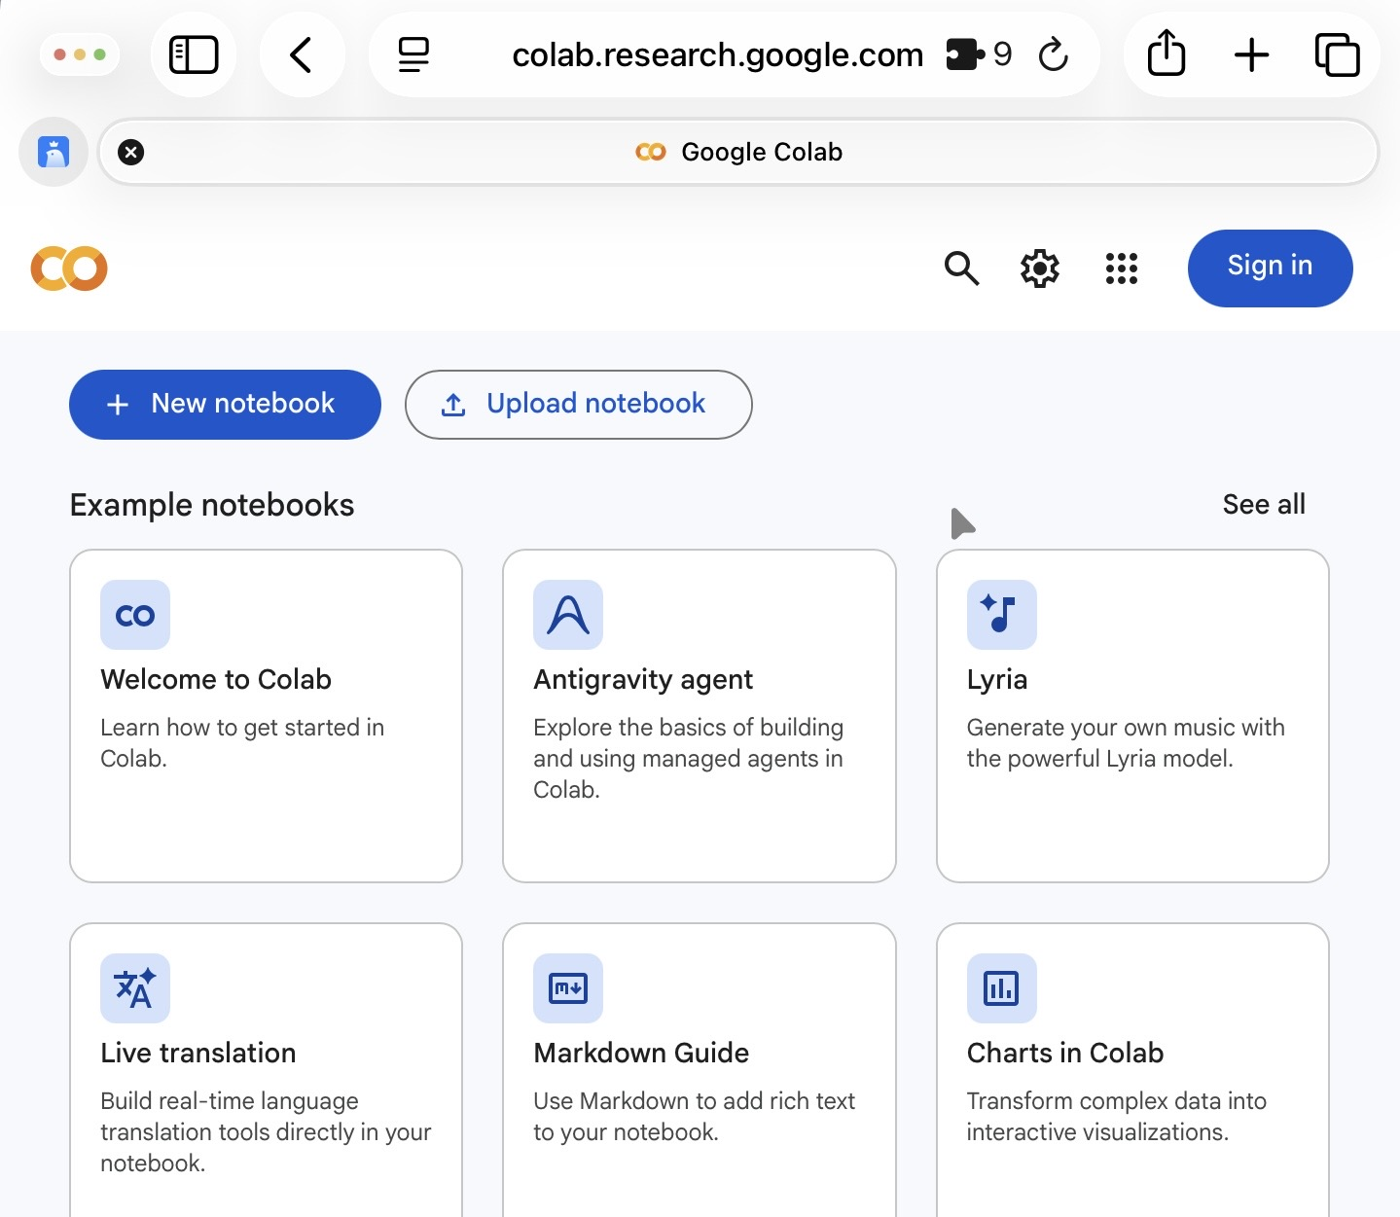

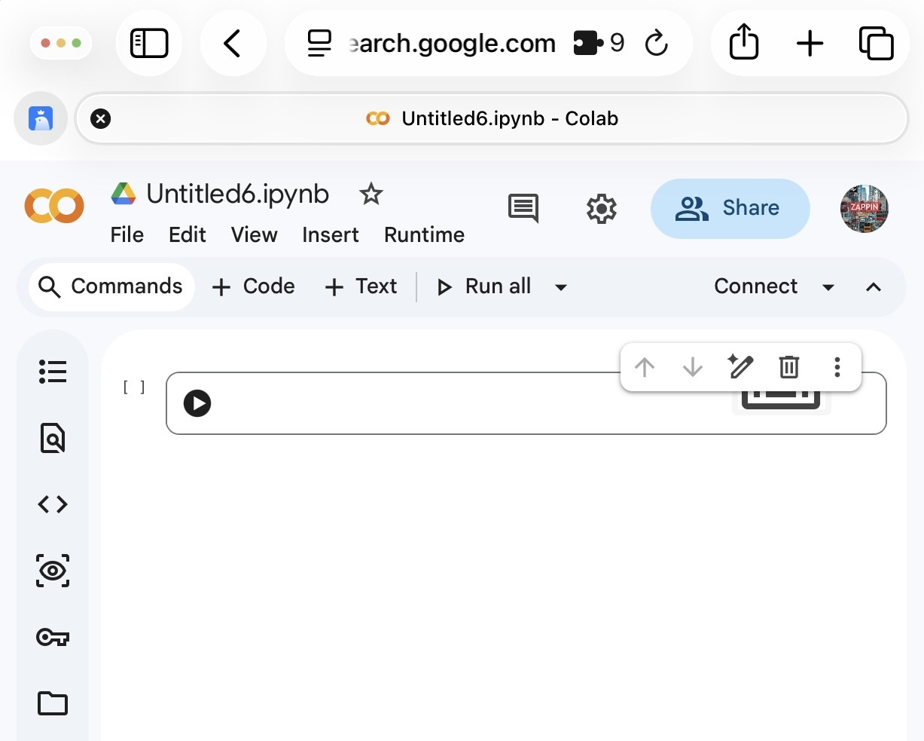
2.1 Creating Your Account
1
Open Google Colab
2
Access with Email
3
Complete Registration
Open the Google Colab website (https://colab.research.google.com/).
Google Colab is fully integrated with Gmail, so you can easily sign in and start using it right away.
Once you're signed in, follow the simple steps to complete your registration and start using Google Colab.
Login in
Done

Slide 5
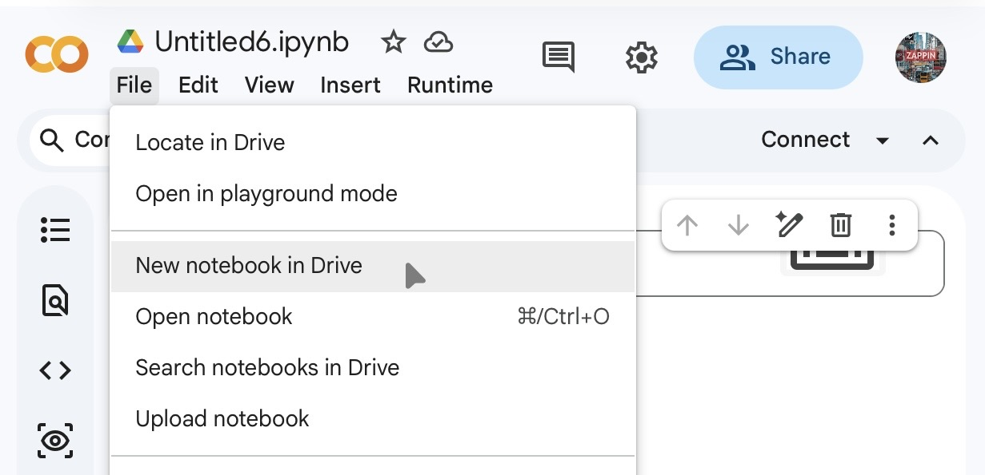
2.2 Creating a New Notebook
Step 1: Click on "New Notebook"
Step 2: Give your notebook a name
In the dashboard, click on the "New Notebook" button to create a new Colab notebook.
A dialog box will appear asking you to provide a name for your notebook. Enter a descriptive name that reflects the purpose of your project.
Click “file”
Click this to change the name
And then, click “create”

Slide 6
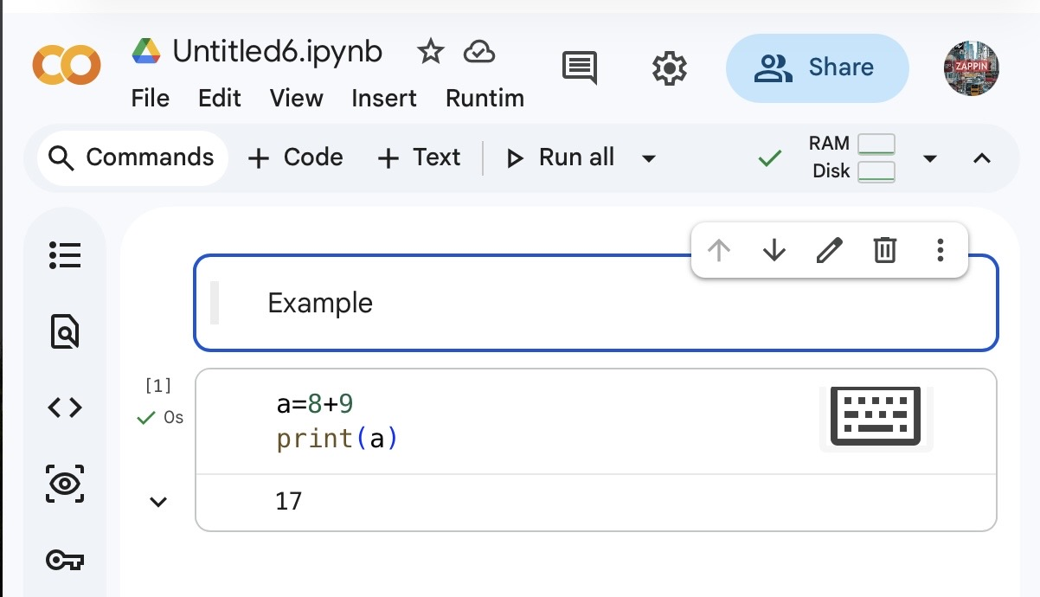
2.3 Understanding the Interface
1
2
3
Menu bar
Code cell
Text cell
It contains various options for managing and running your notebook, such as saving, running code cells, and changing runtime settings.
This is where you can write and run Python code. Each code cell can be run individually.
You can add text explanations or notice using text cells. They are useful for providing instructions or adding comments to your code

Slide 7

2.4 Writing and Running Code
Step 1：Adding a code cell
Step 2：Writing your code
Step 3：Run the code cell
To add a code cell, simply click on the "+" button in the toolbar.
In the code cell, you can write your Python code.
For example
we add 5+9, and we print the rtesult.
print(5+9)
you can click the play button.
Click “add code”

Slide 8
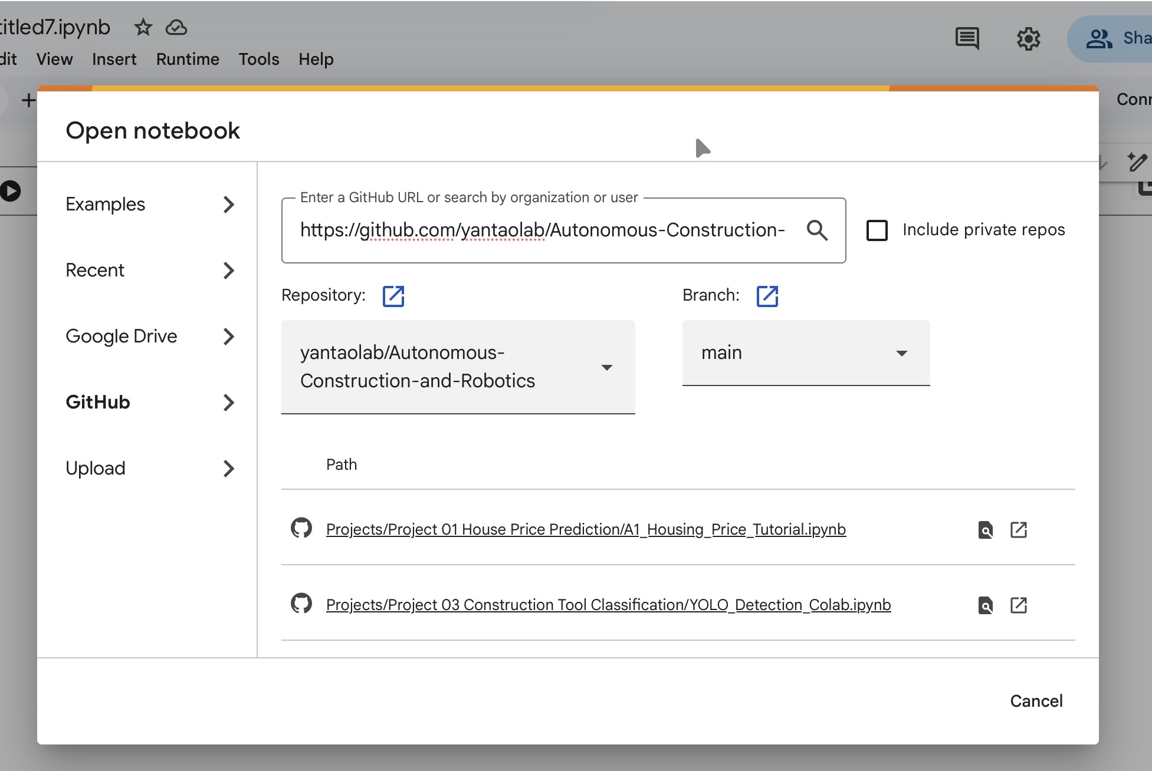
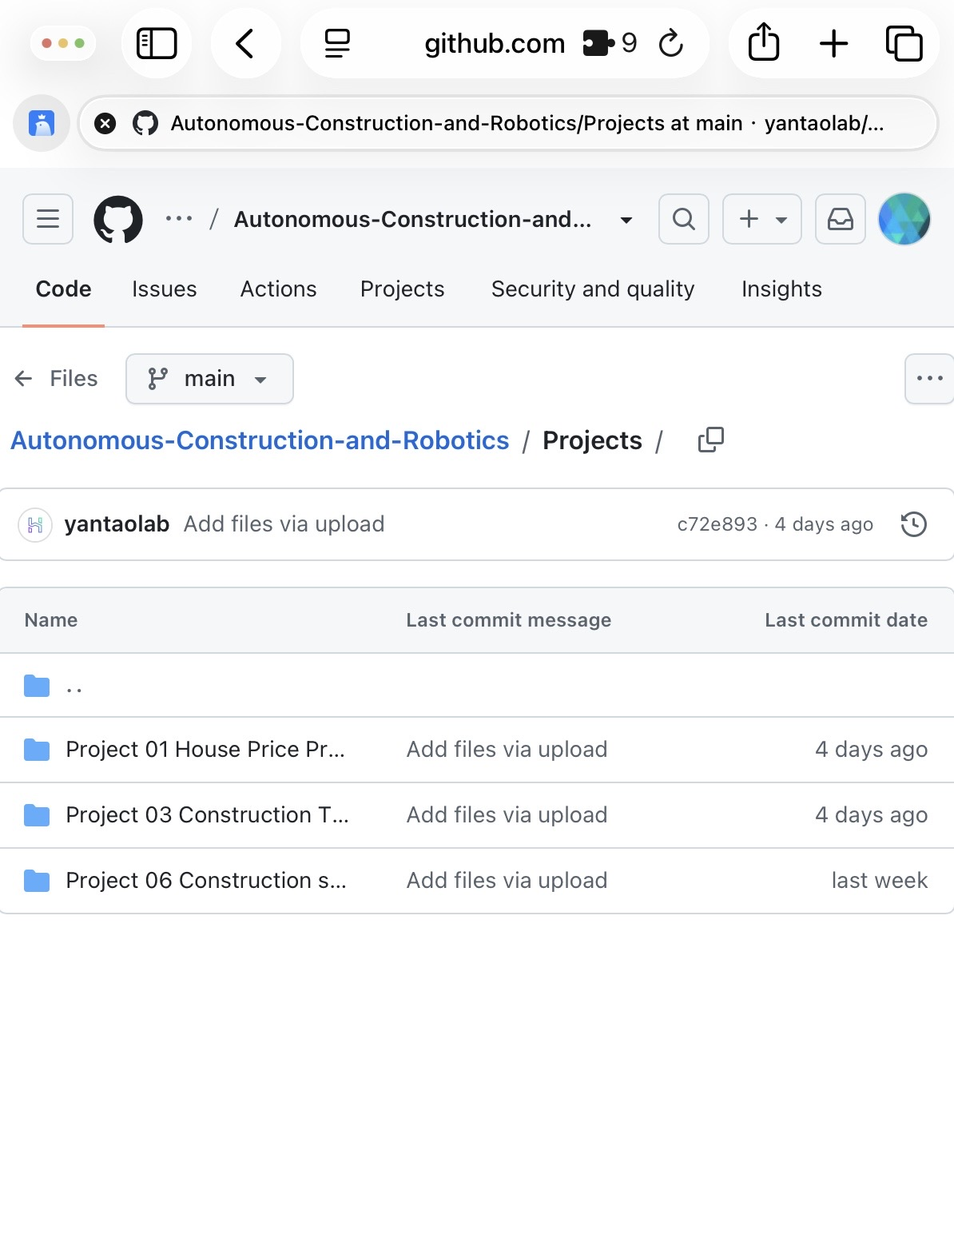
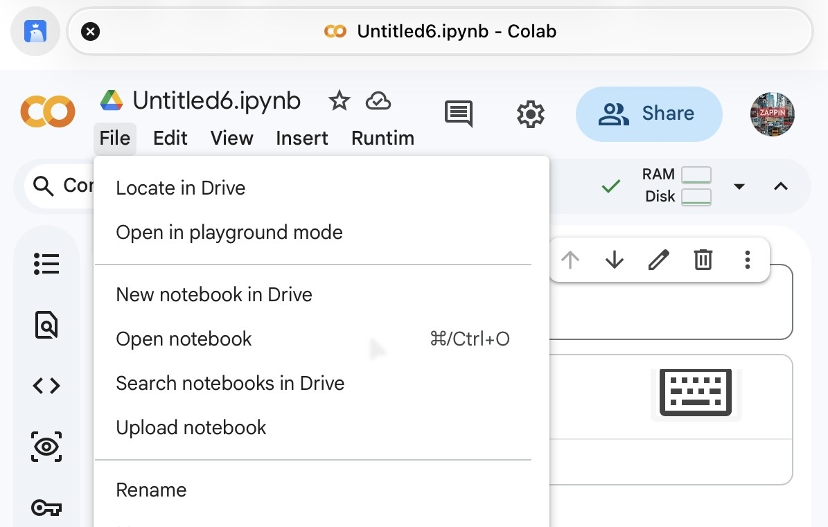
2.5 Import form GitHub
Finding the Code on GitHub
Copying the Repository Link
Open the Colab
Visit the GitHub website (github.com).
Search for the code repository provided for this lesson.
https://github.com/yantaolab/Autonomous-Construction-and-Robotics/tree/main/Projects
Once you have found the repository, locate the "Code" button and click on it. Copy the link.
Open this link from Google Colab.
Copy the link
Step 2
Click this
Step 1

Slide 9
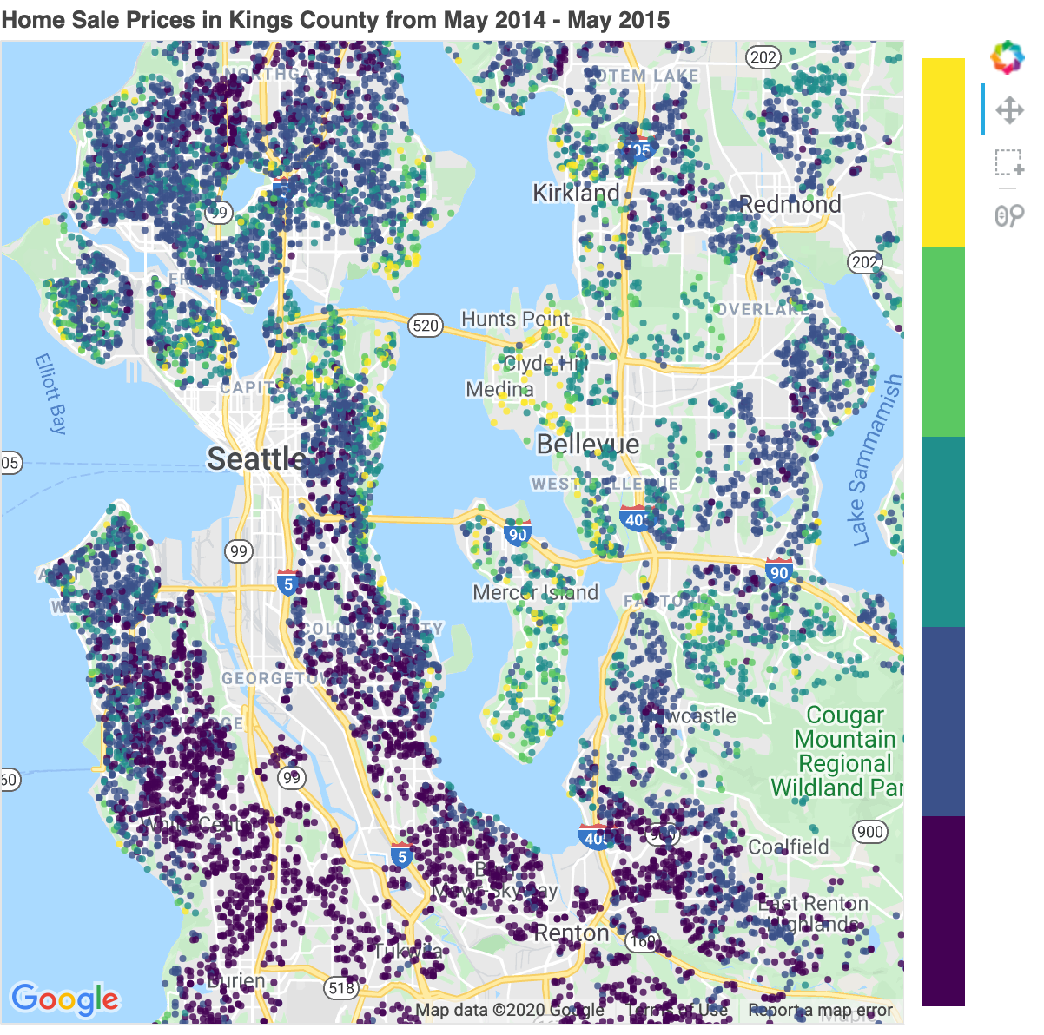
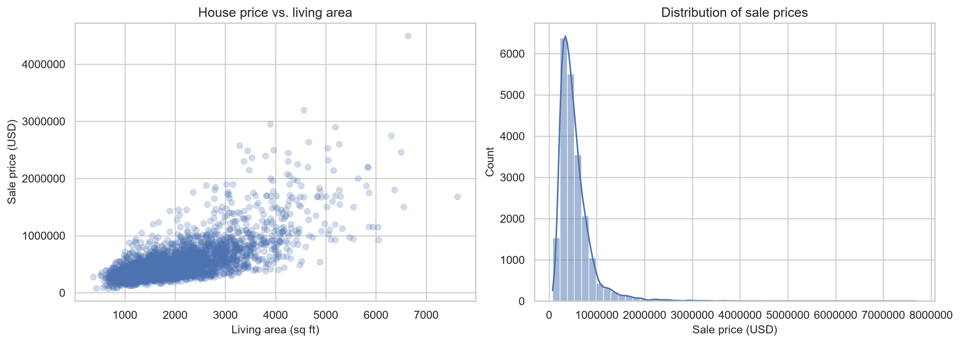
3. Data snapshot
21,613 King County house-sale records.
No missing values in the original CSV.
Repeated IDs exist, so some houses appear more than once.
sqft_living = sqft_above + sqft_basement holds for all rows.
Condition is concentrated around level 3.
Housing price overview from the real dataset.
Notes:
Use this slide to anchor the discussion in the real dataset before any modeling starts.
In this dataset, we need to predict the sales price of houses in King County, Seattle. It includes homes sold between May 2014 and May 2015.
Before doing anything, we should first know about the dataset, what it contains, what its features are, and what the structure of the data is.

Slide 10
3. Data snapshot
The description for the 20 features is given below:
id :- It is the unique numeric number assigned to each house being sold.
date :- It is the date on which the house was sold out.
price:- It is the price of house which we have to predict so this is our target variable and aprat from it are our features.
bedrooms :- It determines number of bedrooms in a house.
bathrooms :- It determines number of bathrooms in a bedroom of a house.
sqft_living :- It is the measurement variable which determines the measurement of house in square foot.
sqft_lot : It is also the measurement variable which determines square foot of the lot.
floors : It determines total floors means levels of house.
waterfront : This feature determines whether a house has a view to waterfront 0 means no 1 means yes.
view : This feature determines whether a house has been viewed or not 0 means no 1 means yes.

Slide 11
3. Data snapshot
The description for the 20 features is given below:
(11) condition : It determines the overall condition of a house on a scale of 1 to 5.
(12) grade : It determines the overall grade given to the housing unit, based on King County grading system on a scale of 1 to 11
(13) sqft_above : It determines square footage of house apart from basement.
(14) sqft_basement : It determines square footage of the basement of the house.
(15) yr_built : It detrmines the date of building of the house.
(16) yr_renovated : It detrmines year of renovation of house.
(17) zipcode : It determines the zipcode of the location of the house.
(18) lat : It determines the latitude of the location of the house.
(19) long : It determines the longitude of the location of the house.
(20) sqft_living15 : Living room area in 2015(implies-- some renovations)
(21) sqft_lot15 : lotSize area in 2015(implies-- some renovations)

Slide 12
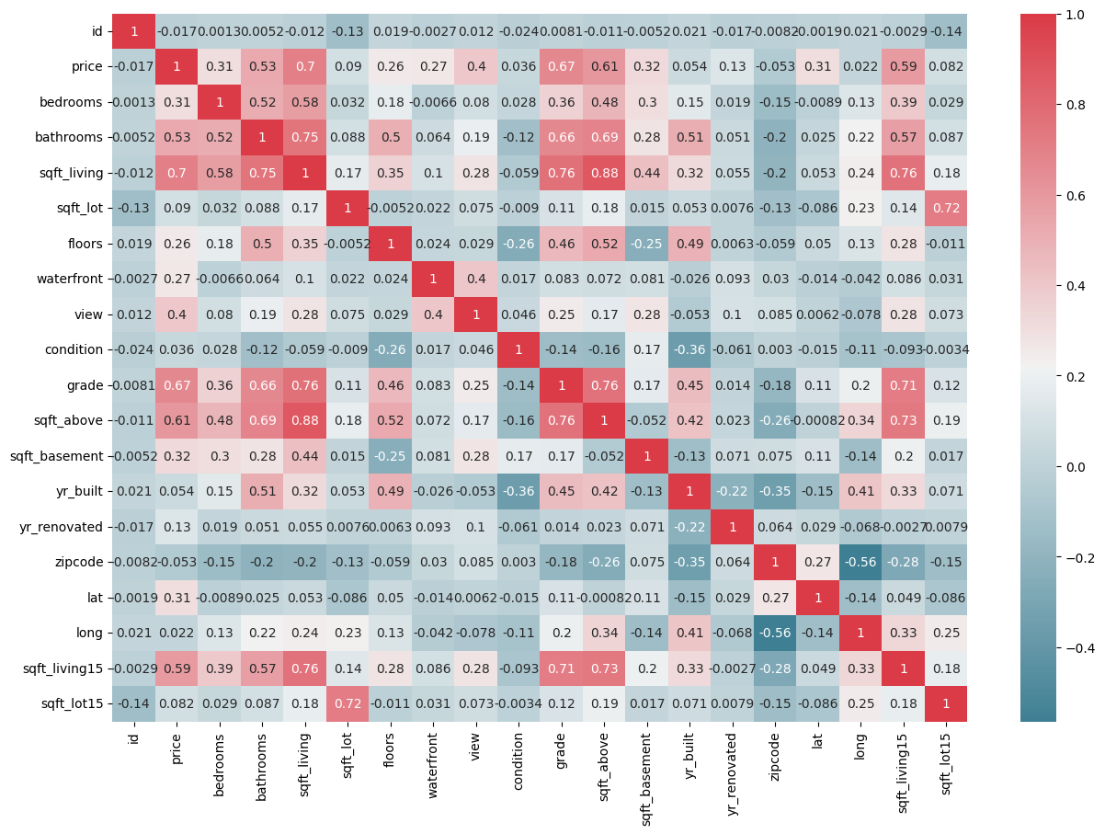
3. Data snapshot
What is this?
A house price correlation heatmap shows the relationships between different factors that can affect house prices, such as location, size, number of bedrooms, or amenities.
Notes:
Darker colors may indicate stronger correlations.
Lighter colors may indicate weaker correlations.

Slide 13
3. Data snapshot
What is this?
Variables Analyzed:
Common variables include square footage, number of bedrooms, bathrooms, age of the home, location, and features like pools or garages.
Correlation Coefficient:
The heatmap uses a correlation coefficient (usually between -1 and 1) to show relationships:
1 means a perfect positive correlation (as one increases, the other does too).
-1 means a perfect negative correlation (as one increases, the other decreases).
0 means no correlation.
Color Coding:
Different colors represent different levels of correlation. For example:
Darker colors may indicate stronger correlations.
Lighter colors may indicate weaker correlations.

Slide 14
3. Data snapshot
What can it do?
It helps real estate professionals and buyers understand which features most influence house prices. Buyers can use this information to make informed decisions about what features to prioritize.
Sellers can understand what aspects of their home might increase its value.
For example, if the heatmap shows a strong correlation between square footage and price, it suggests larger homes tend to sell for more.

Slide 15
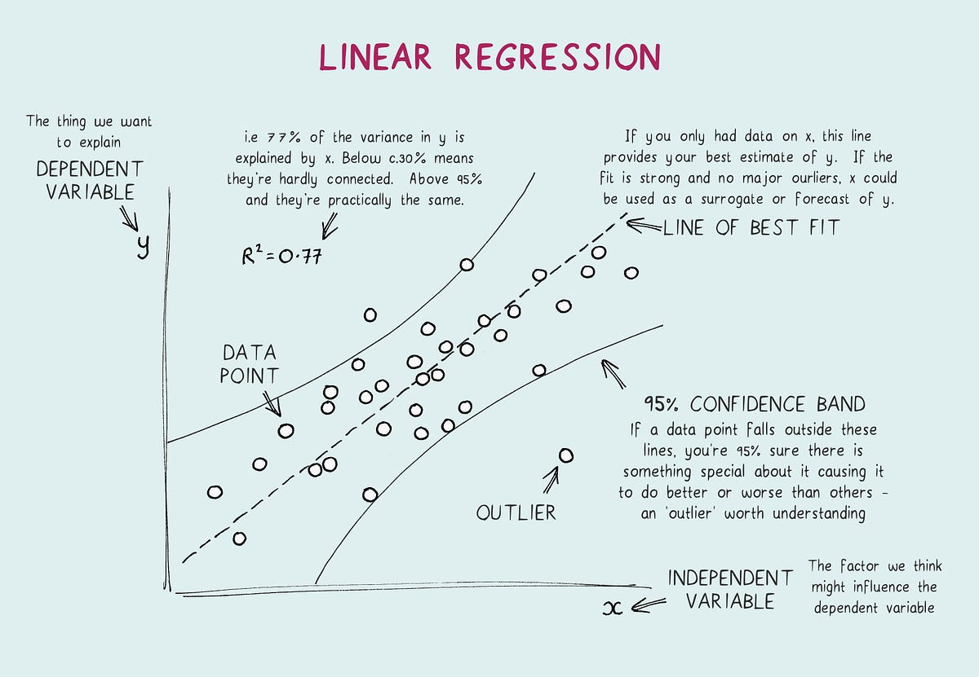
4. Baseline model
What is this?
Linear Regression Analysis consists of more than just fitting a linear line through a cloud of data points. It consists of 3 stages.
Analyzing the correlation and directionality of the data
Estimating the model, i.e., fitting the line
Evaluating the validity and usefulness of the model

Slide 16
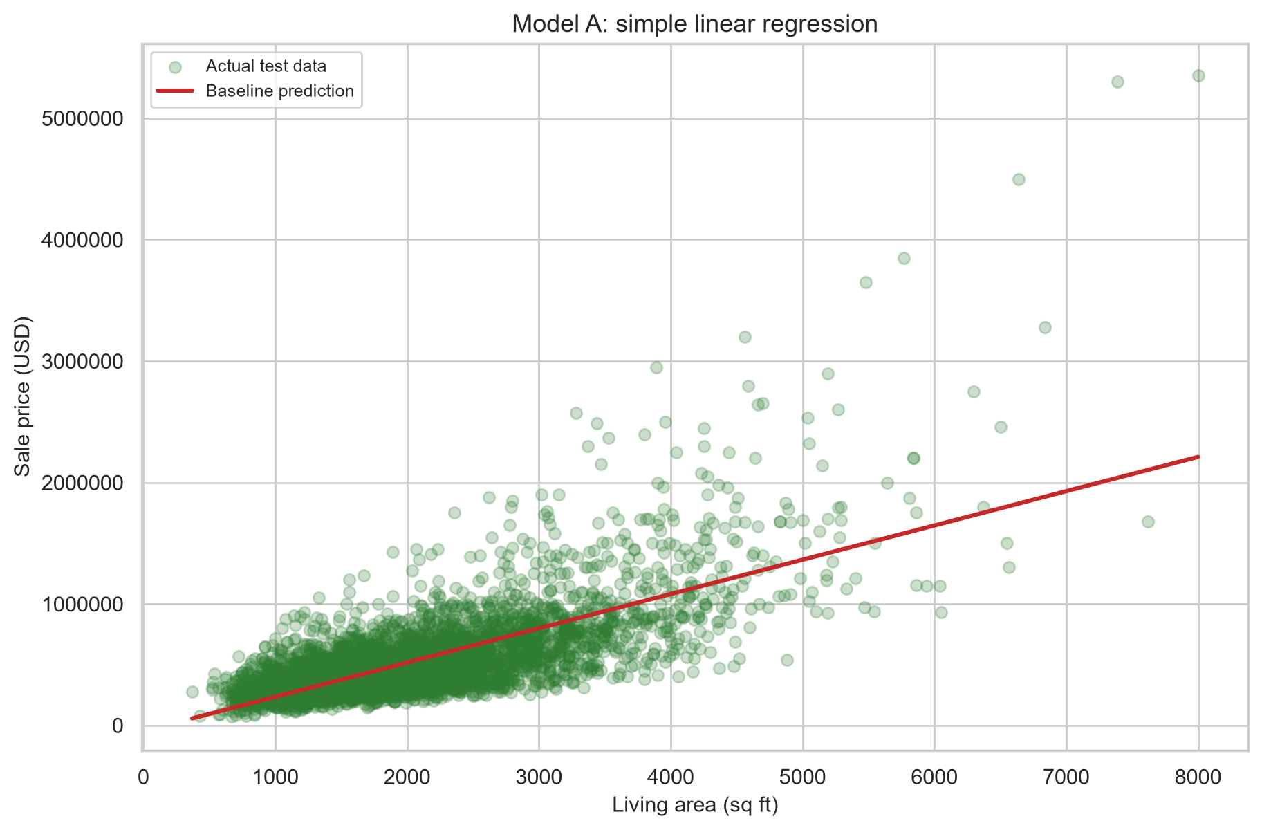
4. Baseline model
Model A uses only sqft_living.
This is a simple and transparent starting point.
It is a baseline, not the final answer.
Guided-solution test R²: 0.496.
Guided-solution test MAE: 169,638 USD.
Why Model A is insufficient?
Housing prices depend on more than floor area.
Location, quality, and neighbourhood context are omitted.
Outliers and luxury homes are hard for a straight line to capture.
Repeated IDs and special properties can add noise.
We need Model B!
Notes:
Pause after the baseline plot and ask why a single size variable cannot explain the full house price variation.

Slide 17
5. Feature engineering task
Ask students to choose at least four features.
Recommended set:
grade, bathrooms, waterfront, view, condition, house_age, lat, long, sqft_living15.
Why these?
They represent quality, location, age, and neighbourhood context.
OR
grade: captures overall construction quality.
bathrooms: captures internal layout and utility.
waterfront: captures a premium location attribute.
condition: captures maintenance state.
house_age: captures depreciation and age effects.
lat / long: capture spatial variation in the housing market.
sqft_living15: captures neighbourhood context through nearby houses.
Notes:
Let students propose alternatives first, then reveal the suggested set.

Slide 18
6. Guided-solution results
Model | Test R² | MAE (USD) | RMSE (USD)
Model A: Baseline | 0.496 | 169,638 | 254,289
Model B: Improved | 0.697 | 125,522 | 197,346
A model comparison should use the same train/test split so that the only meaningful difference is the model itself.
• Same training data: Each model learns from the same examples.
• Same test data: Each model is evaluated on the same cases, including the same easy and difficult examples.
• Less sampling noise: Different splits can produce different scores simply because one test set is easier or harder.
• Fair attribution: Any performance difference is more likely due to the algorithms, not differences in the data partition.
For example, if Model A gets an easier test set and Model B gets a harder one, comparing their accuracy is not fair—even if both models are equally good.
Notes:
The improved model increases test R² by +0.200 and reduces MAE by 26.0%.

Slide 19
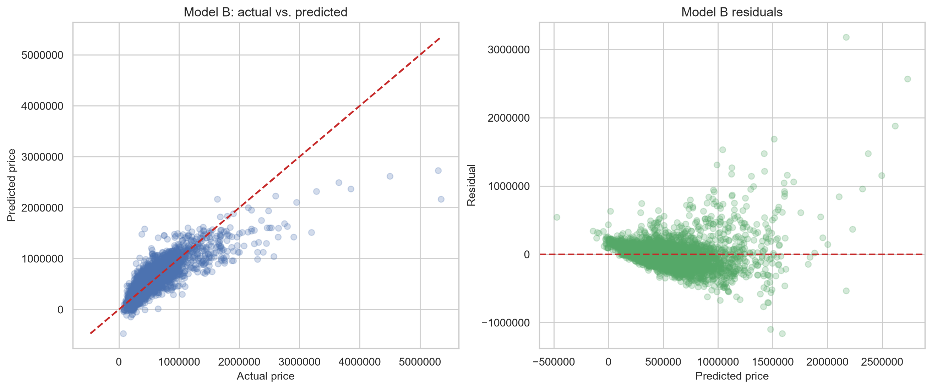
7. Error analysis
Inspect residual plots, not just one metric.
Large errors often belong to luxury houses or unusual locations.
Some predictive signals are still missing from the model.
Discuss at least two error sources with evidence.
Notes:
Ask the class what the top-error observations have in common before you explain the likely causes.

Slide 20
8. Submission checklist
List the features you added.
Report the two model metrics tables.
State which model is better and why.
Explain two error sources.
Export the completed work to PDF and submit in class.
What you need to submit to Canvas is a PDF file named “A1_YourName.pdf”.
Notes:
Close by reminding students that the assignment is now an in-class task.

Slide 21
9. References
Rafiei, M. H., & Adeli, H. (2016). A novel machine learning model for estimation of sale prices of real estate units. Journal of Construction Engineering and Management, 142(10), 04016053. https://doi.org/10.1061/(ASCE)CO.1943-7862.0001047
Soltani, A., Heydari, M., Aghaei, F., & Pettit, C. J. (2022). Housing price prediction incorporating spatio-temporal dependency into machine learning algorithms. Cities, 131, 103941. https://doi.org/10.1016/j.cities.2022.103941
Calainho, F. D., van de Minne, A. M., & Francke, M. K. (2024). A machine learning approach to price indices: Applications in commercial real estate. Journal of Real Estate Finance and Economics, 68(4), 1308–1339. https://doi.org/10.1007/s11146-022-09893-1

